Slide 1
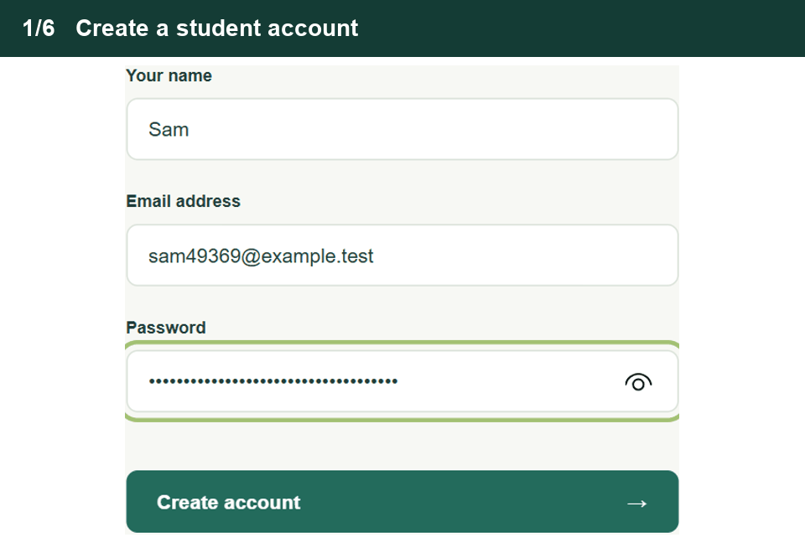
A student’s first session in Recall
Student walkthrough
1. Create an account
Register with a name, email and password.
2. Start a session
Open Practice and choose Memory.
3. Answer and review
Answer three questions and check the points you covered.
4. View your portfolio
Compare the results and pick a topic to revisit.
Notes:
Start Slide Show and pause on this slide for 24 seconds. The six captured screens play automatically and loop. They follow one sample student through registration, topic selection, retrieval practice, answer review and the saved Memory portfolio.

Slide 2
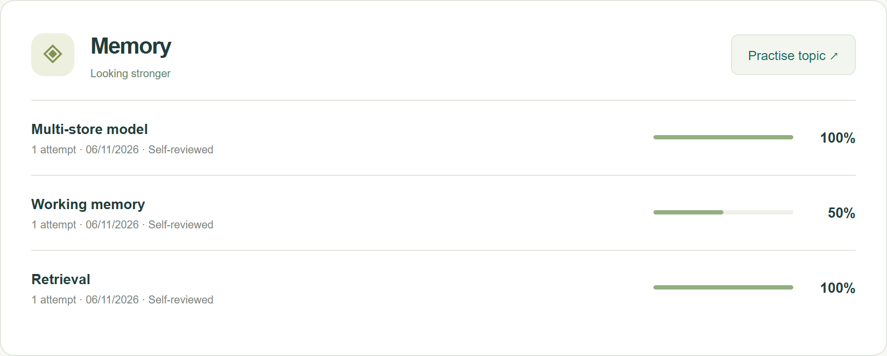
Recall’s A-level Psychology revision demo
Memory practice
Student portfolio after three questions
“Explain the role of the central executive in working memory.”
The student answers, “It directs attention.”
Recall flags one of two answer points by keyword. The student confirms that their answer covered attention.
Next time, explain how the central executive coordinates the other components.
Live prototype
<URL>
Notes:
Before presenting, replace <URL> with your prototype link. Sign in to a demo student account and open Practice → Memory. For a short live demo, complete the first question beforehand and pause on the second.
Ask the audience what is missing from “It directs attention.” Enter the answer, select a confidence level and click Check my answer. Show the two answer points. Attention is covered. Coordinating the other components and allocating resources is the missing point. Confirm the checkboxes and click Save review & continue.
Finish the retrieval question and open the portfolio. The 50% shown here means the student covered one of the two points in their latest working-memory answer. A teacher can inspect the saved answer in the admin dashboard and ask the student to explain how the central executive coordinates the phonological loop and visuospatial sketchpad.
This demonstration uses a sample student session. The prototype uses keyword checks and student self-review. No AI service is connected.

